Slide 1
Module-01: C Programming Basics Part-4: Expressions and Branches
CS 1714 – Computer Programming II

Slide 2
Relational Expressions
Relational expressions in C use the same relational operators in Java and many other languages:
However, relational expressions are handled differently in C compared to Java.
In Java, relational expressions evaluate to true or false, which are boolean values.
In ANSI C, there are no default boolean types nor are there true and false values. In C, relational expressions evaluate to 0 for false or non-zero (usually 1) for true.
! | < | <= | > | >= | == | != | && | ||

Slide 3
Evaluating Relational Expressions
Here is an example of what relational expressions evaluate to:
foo’s relational expression evaluates to true, so its value 1 whereas bar’s relational expression evaluates to false, so its value is 0.
Source Code
int foo = 17 > 14;
int bar = 17 < 14;
printf("%d\n", foo);
printf("%d\n", bar);
Output
1
0

Slide 4
Booleans in C - Macros Approach
There are a couple ways to use boolean values, when you need to explicitly use true and false.
The macros approach is to use preprocessor directives to define true and false macros as 1 and 0 to represent these "boolean" values
#define TRUE 1
#define FALSE 0

Slide 5
Booleans in C - stdbool.h
The bool data type was defined in C99 along with the values of true and false. You will need to include the header file stdbool.h to use it.
When printing, the bool variable is treated as an integer. This printf() will print out the number 1.
bool isWinner = true;
printf("%d", isWinner);

Slide 6
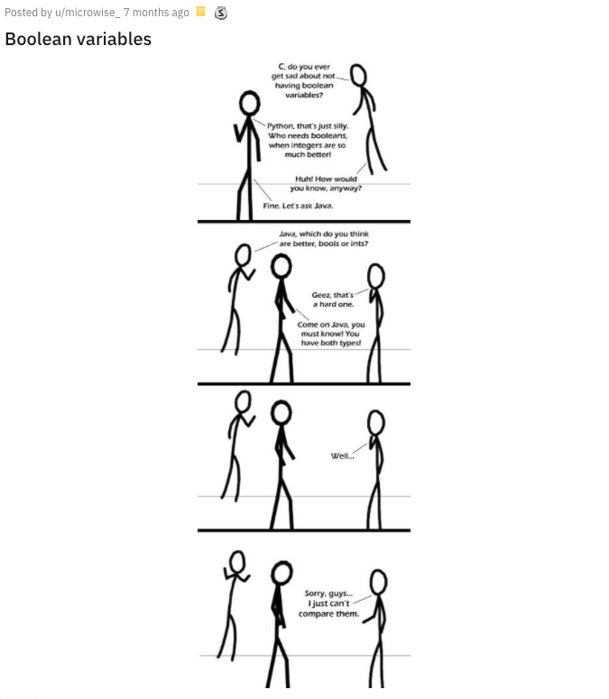
Booleans in C
Boolean values are usually implied. That is, we just need to know if an expression evaluates to true or false. We do not usually make a comparison with the relational expression against true or false.
So, we rarely need to use the literals true and false, especially since we have some alternatives in ANSI C, such as using 1 and 0 instead.
Therefore, we will not actively use the bool type nor the stdbool.h header file.

Slide 7
Relational Expressions
Since C evaluates relational expressions to 0 or 1, it is possible to mix other types of expressions like arithmetic and assignment expressions. Consider this if statement where we accidentally left out an equal sign in the equality check.
int foobar = 0;
if(foobar = 0)
{
printf("Foobar is equal to zero.\n");
}
else
{
printf("Foobar is not equal to zero.\n");
}

Slide 8
Relational Expressions
In Java, this expression would not be permitted because it does not evaluate to a true or false; that is, it’s not a relational expression, which if needs.
In C, this assignment expression in an if-statement is permitted and an assignment statement evaluates to the value being assigned. In this example, foobar assigned to 0 in the if() means this expression evaluates to 0 and in C, 0 is false. So, the printf() does not execute.
int foobar = 0;
if(foobar = 0)
{
printf("Foobar is equal to zero.\n");
}
else
{
printf("Foobar is not equal to zero.\n");
}

Slide 9
Relational Expressions
if-statements, with and without else statements, are the same in C as is in Java
int a = 10;
int b = 20;
if(a > b)
{
printf("A > B");
}
int a = 10;
int b = 20;
if(a > b)
{
printf("A > B");
}
else
{
printf("B >= A");
}
int a = 10;
int b = 20;
if(a > b)
{
printf("A > B");
}
else if(b > a)
{
printf("B > A");
}
else
{
printf("A == B");
}

Slide 10
Ternary Operator
Convert if-else block to a single line, using a conditional expression aka ternary operator
if(condition)
{
myVar = expr1;
}
else
{
myVar = expr2;
}
myVar = (condition) ? expr1 : expr2;

Slide 11
switch case
switch/case is typically faster than a long nested if statement
switch only works with an int or char
default is like the else or catch all
You can have the same code for multiple cases as in the example for <value three> and <value four>
Make sure there is a break; statement after each case statement
switch( <int or char variable> )
{
case <value one>:
<code>
break;
case <value two>:
<code>
<break>;
case <value three>:
case <value four>:
<code>
<break>;
default:
<code>
<break>;
}

Slide 12
switch case

